Slide 1

A Convening to Explore Quality and Equity in the New Credentialing Landscape
September 11-12, 2019
Fairmont Hotel, Dallas, Texas
Notes:
Change background to reflect design of report?

Slide 2

The Context
We face an urgent challenge to address the demands of a competitive global economy and to assure more equitable access to economic opportunity, social mobility, and meaningful civic participation.
65%
of all jobs will require some level of postsecondary education by 2020.
34%
11%
39%
59%
of employers say
colleges haven’t prepared students for jobs
of young adults from low income families earn degrees
Difference in voting rates between high school graduates and those with some college or a degree

Slide 3
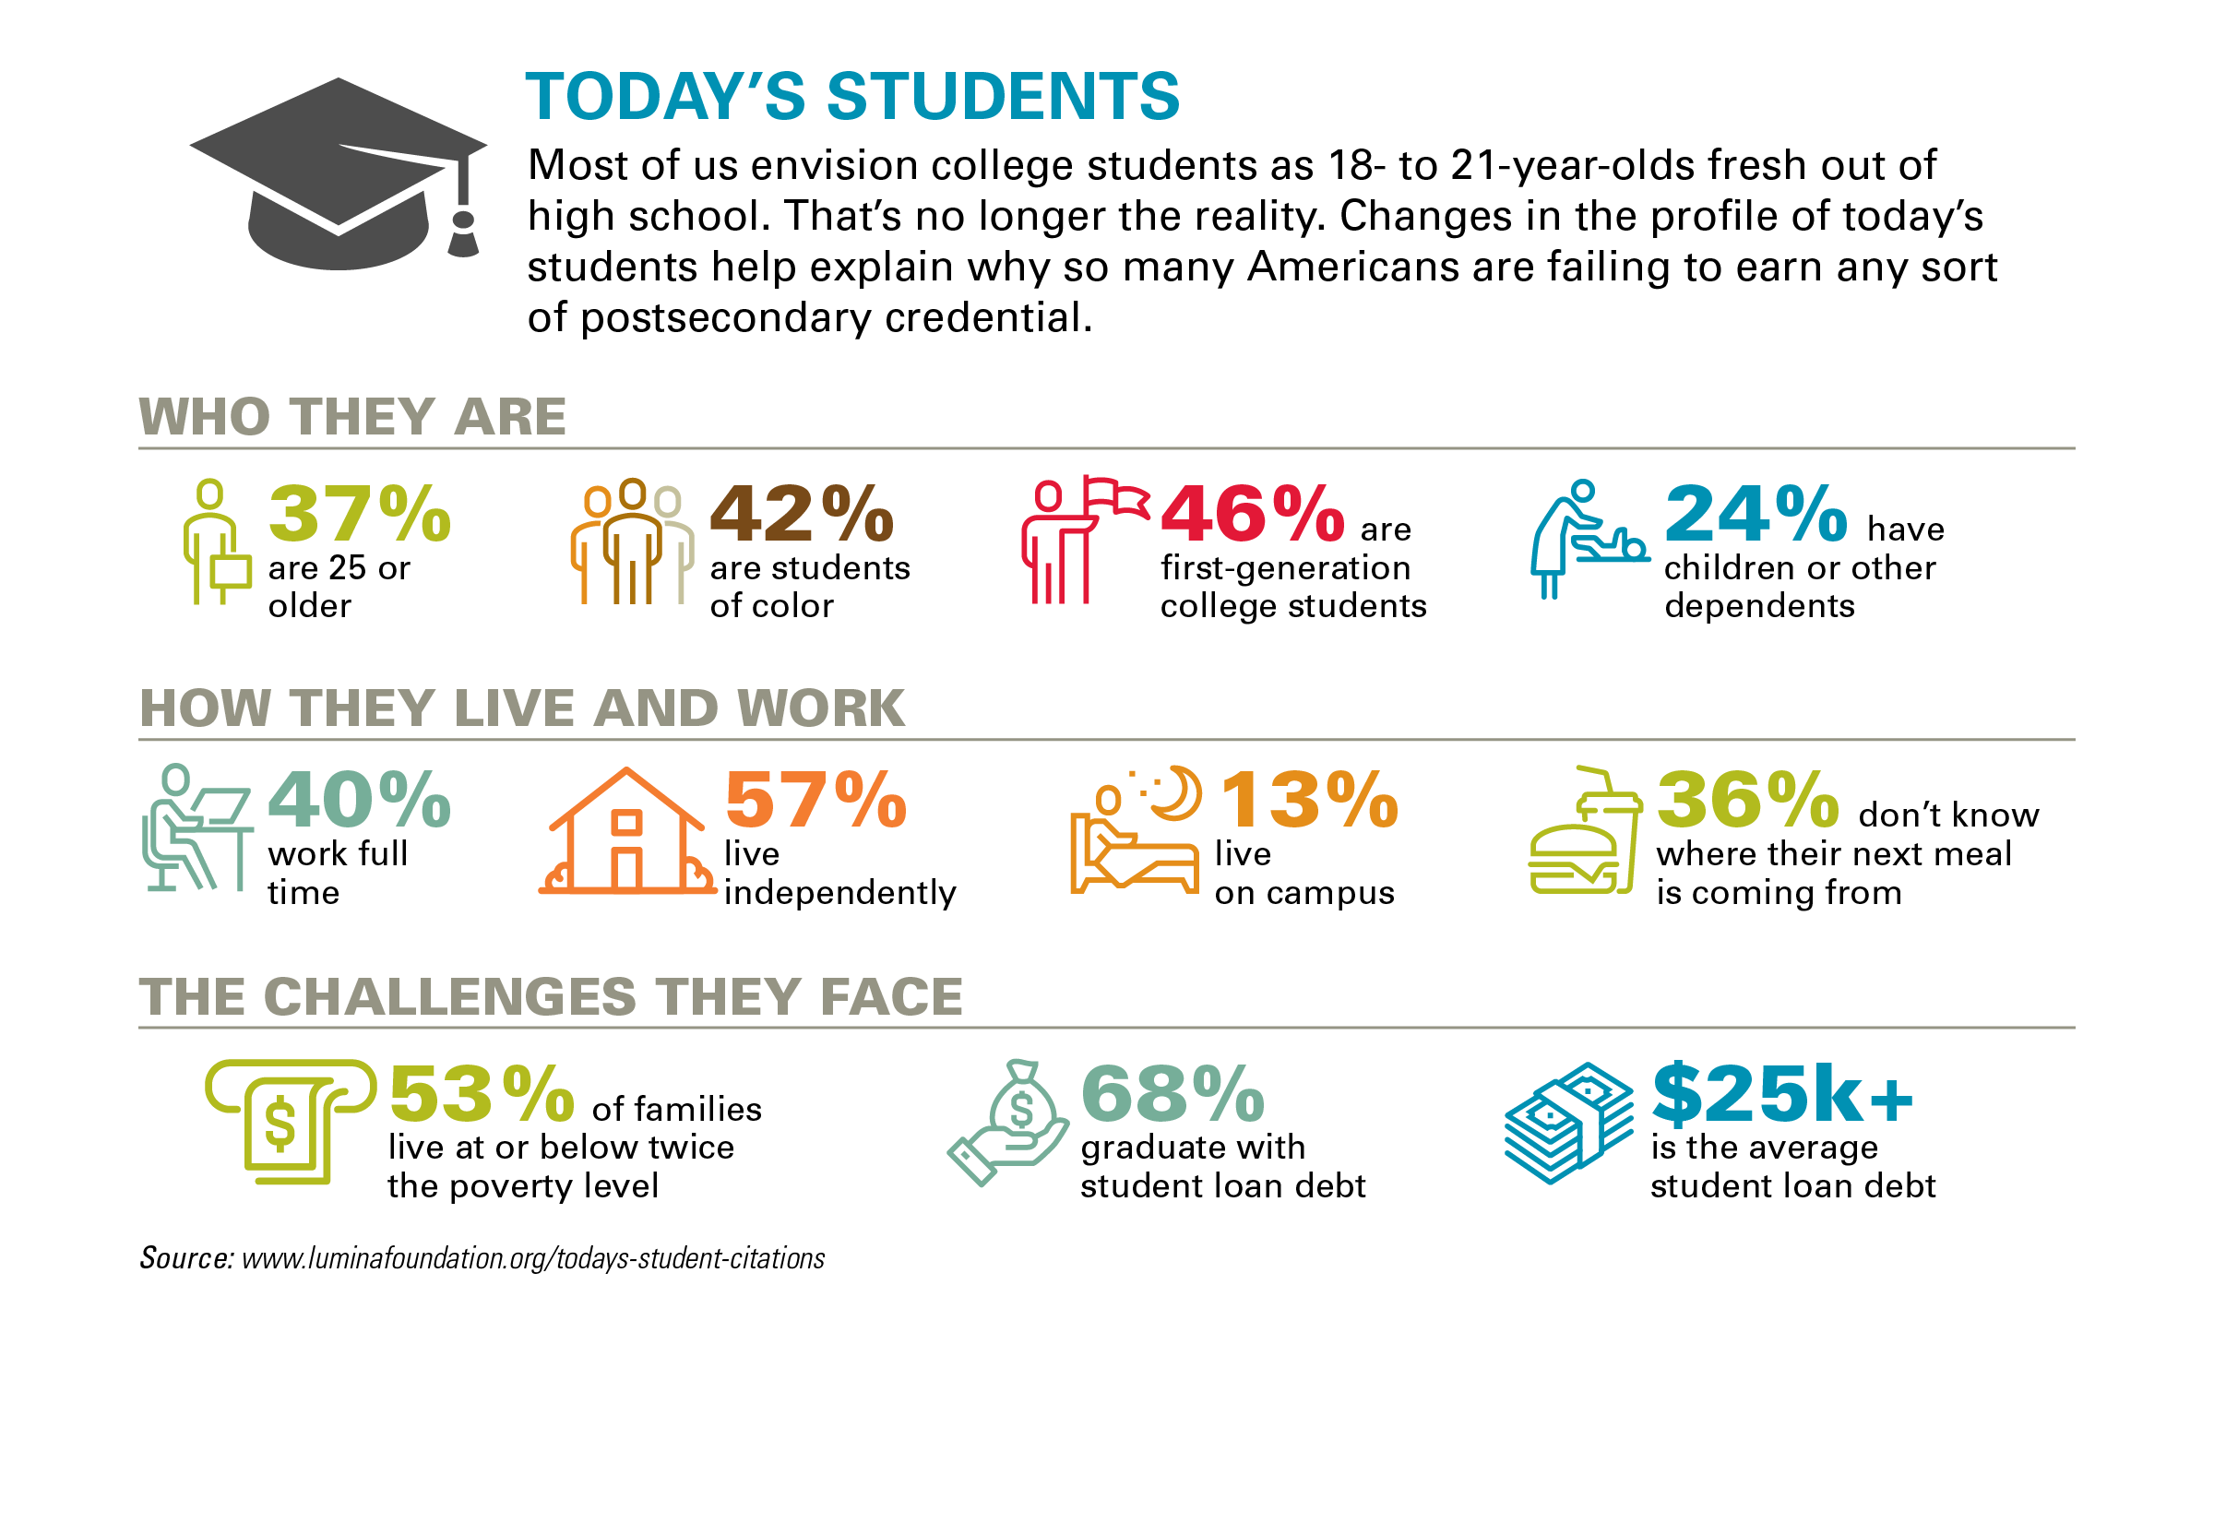
Notes:
We know that the demographics of today’s students (and today’s potential students) are changing. We may not fully realize exactly how much today’s student have changed.
They are older. They are from a wider array of racial/ethnic backgrounds. Many are raising children of their own and are working. And, a very large number come from low-income, low-wealth families.

Slide 4
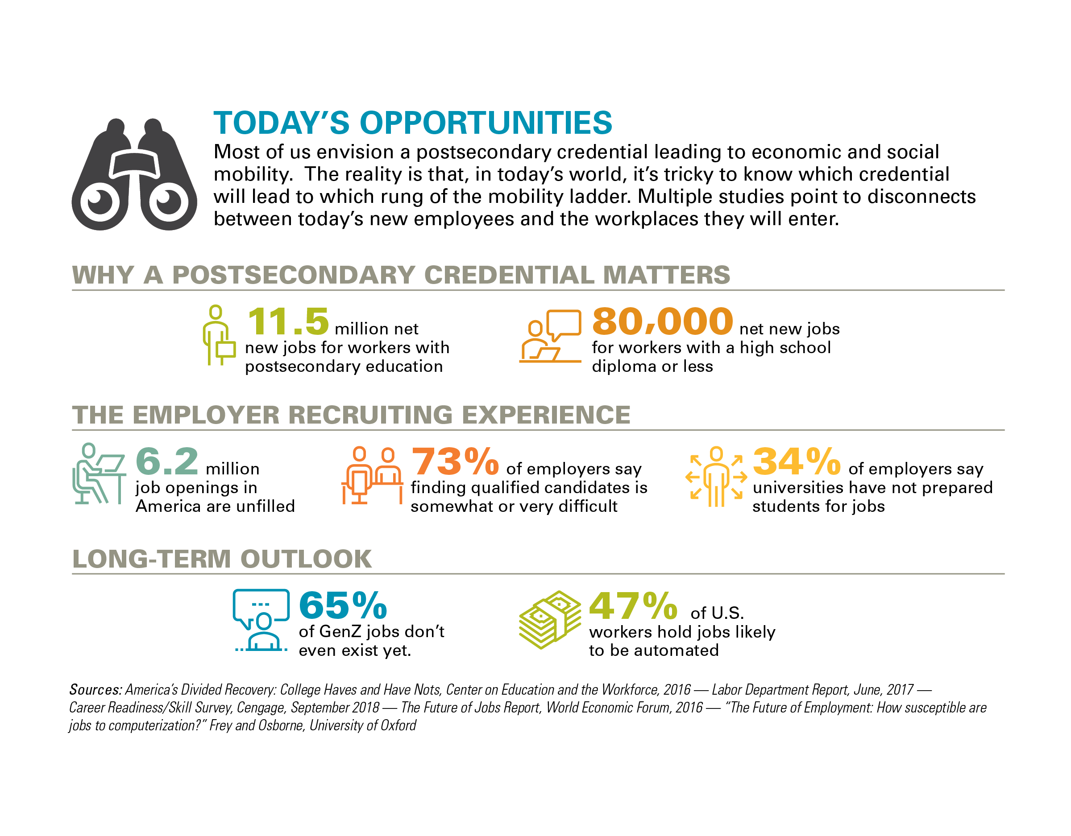
Notes:
We know also that, while people pursue learning beyond high school for many reasons, one of the principal reasons is to improve their opportunities for good jobs and long-term economic success and mobility. But, we also know that the demands of the economy are changing very rapidly.
We’ll dig more deeply this afternoon into the changing economy and what research tells us about the competencies required in that new economy.
Suffice it to say, we considered these realities in thinking thru what the dimensions of quality credentials and the conditions to produce those credentials really needed to be.

Slide 5
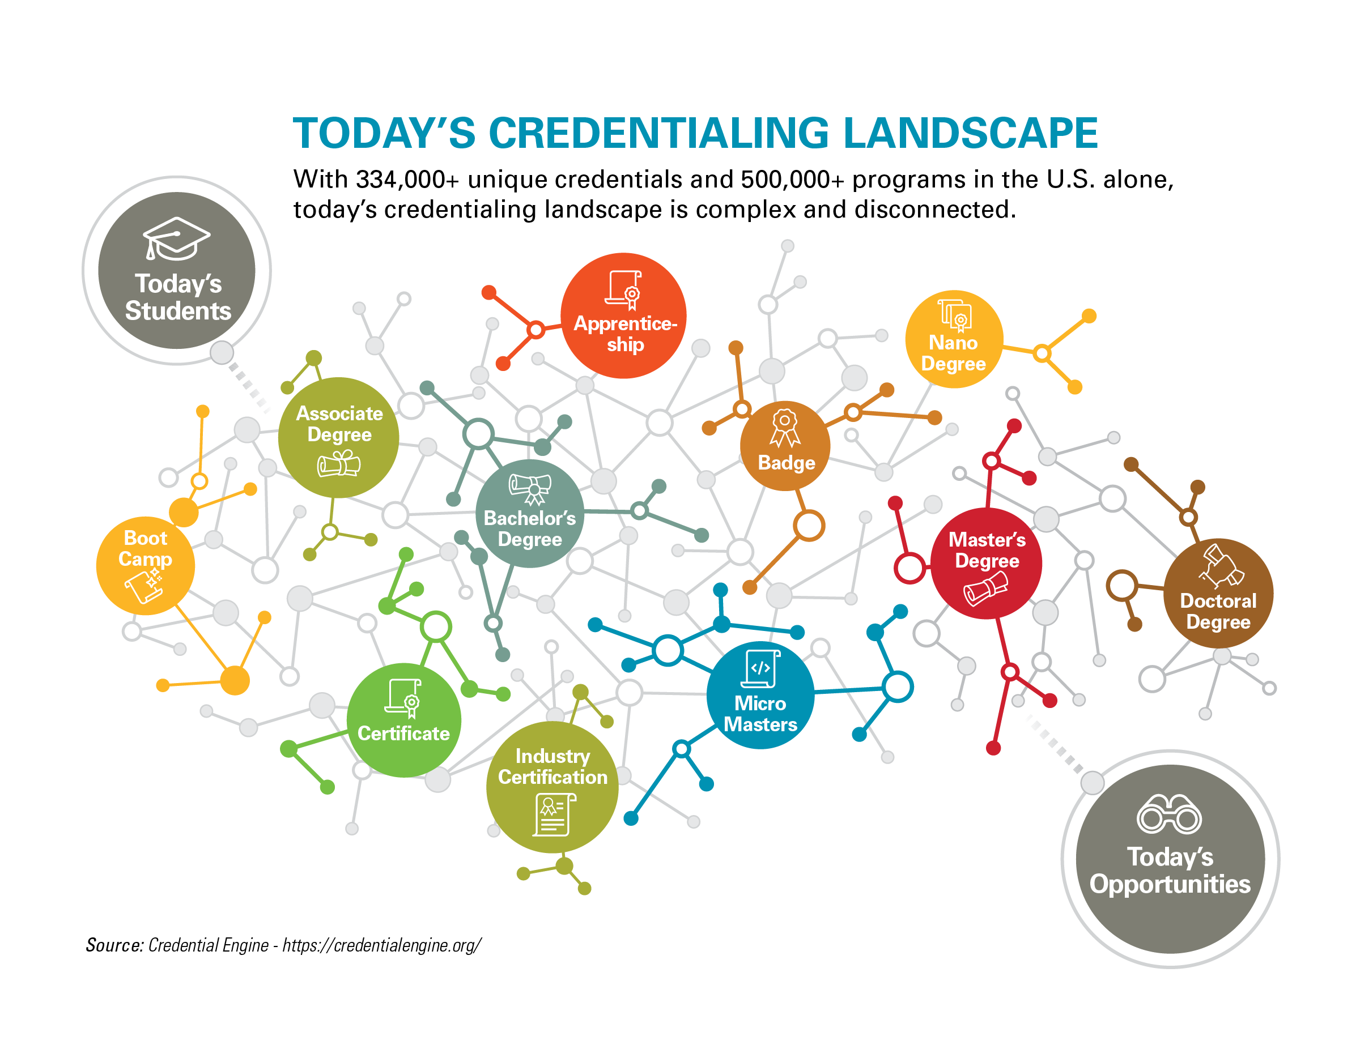
Notes:
Rapidly changing environment and a highly dynamic one—and not a very transparent landscape especially to those who seek the opportunities that these credentials may open up.
There are many credentials and it is a highly fractured environment in which there are far too few pathways between and among different credentials.

Slide 6
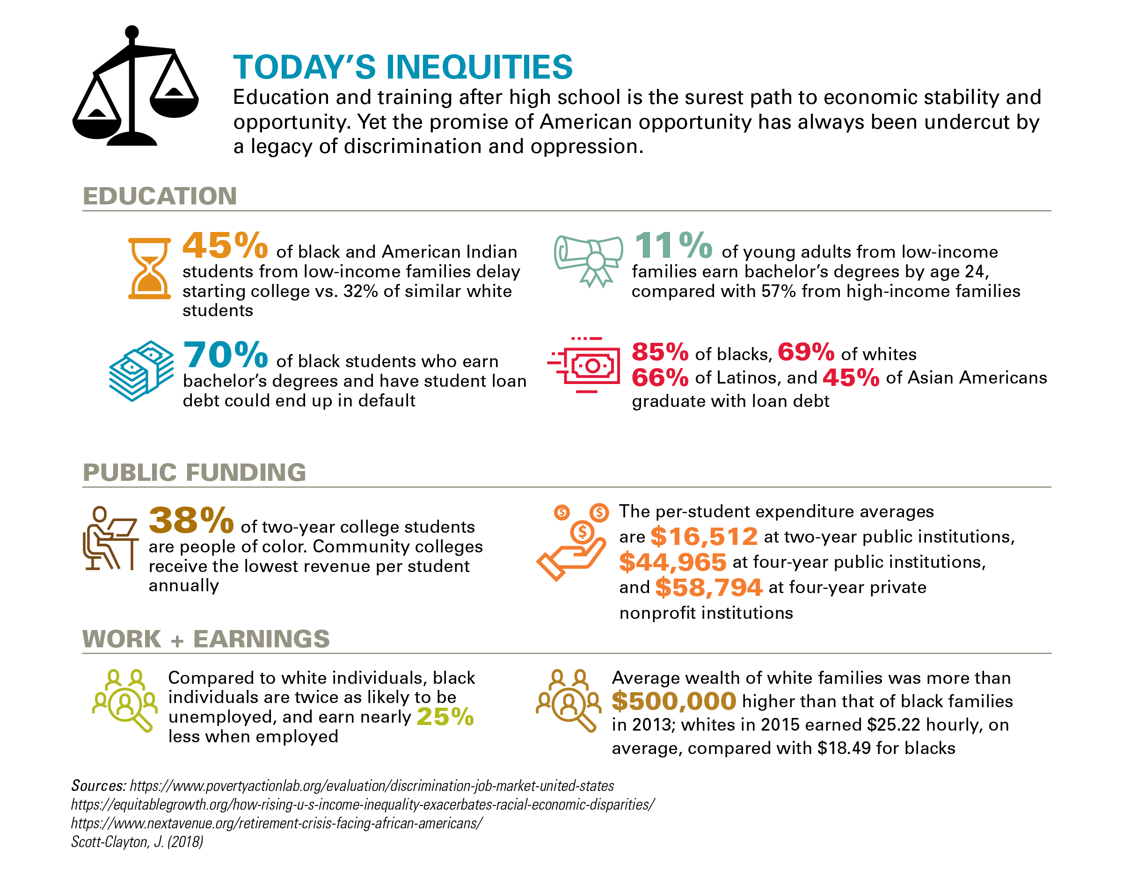
Notes:
Finally, probably the most important context for our work has to do with the inequities currently in the system.
We know that lower income students and Black, Latino and American Indian students are far less likely to even have access to quality programs beyond high school and far fewer, even if they do begin a program, actually get to the finish line. When they pursue college, they also are far more likely to attend institutions with fewer resources.

Slide 7
The Urgent Need
A Next Generation Model to Define Quality, Drive Improvement and Responsible Innovation, and Hold Ourselves Accountable in Rigorous and Fair Ways

Slide 8
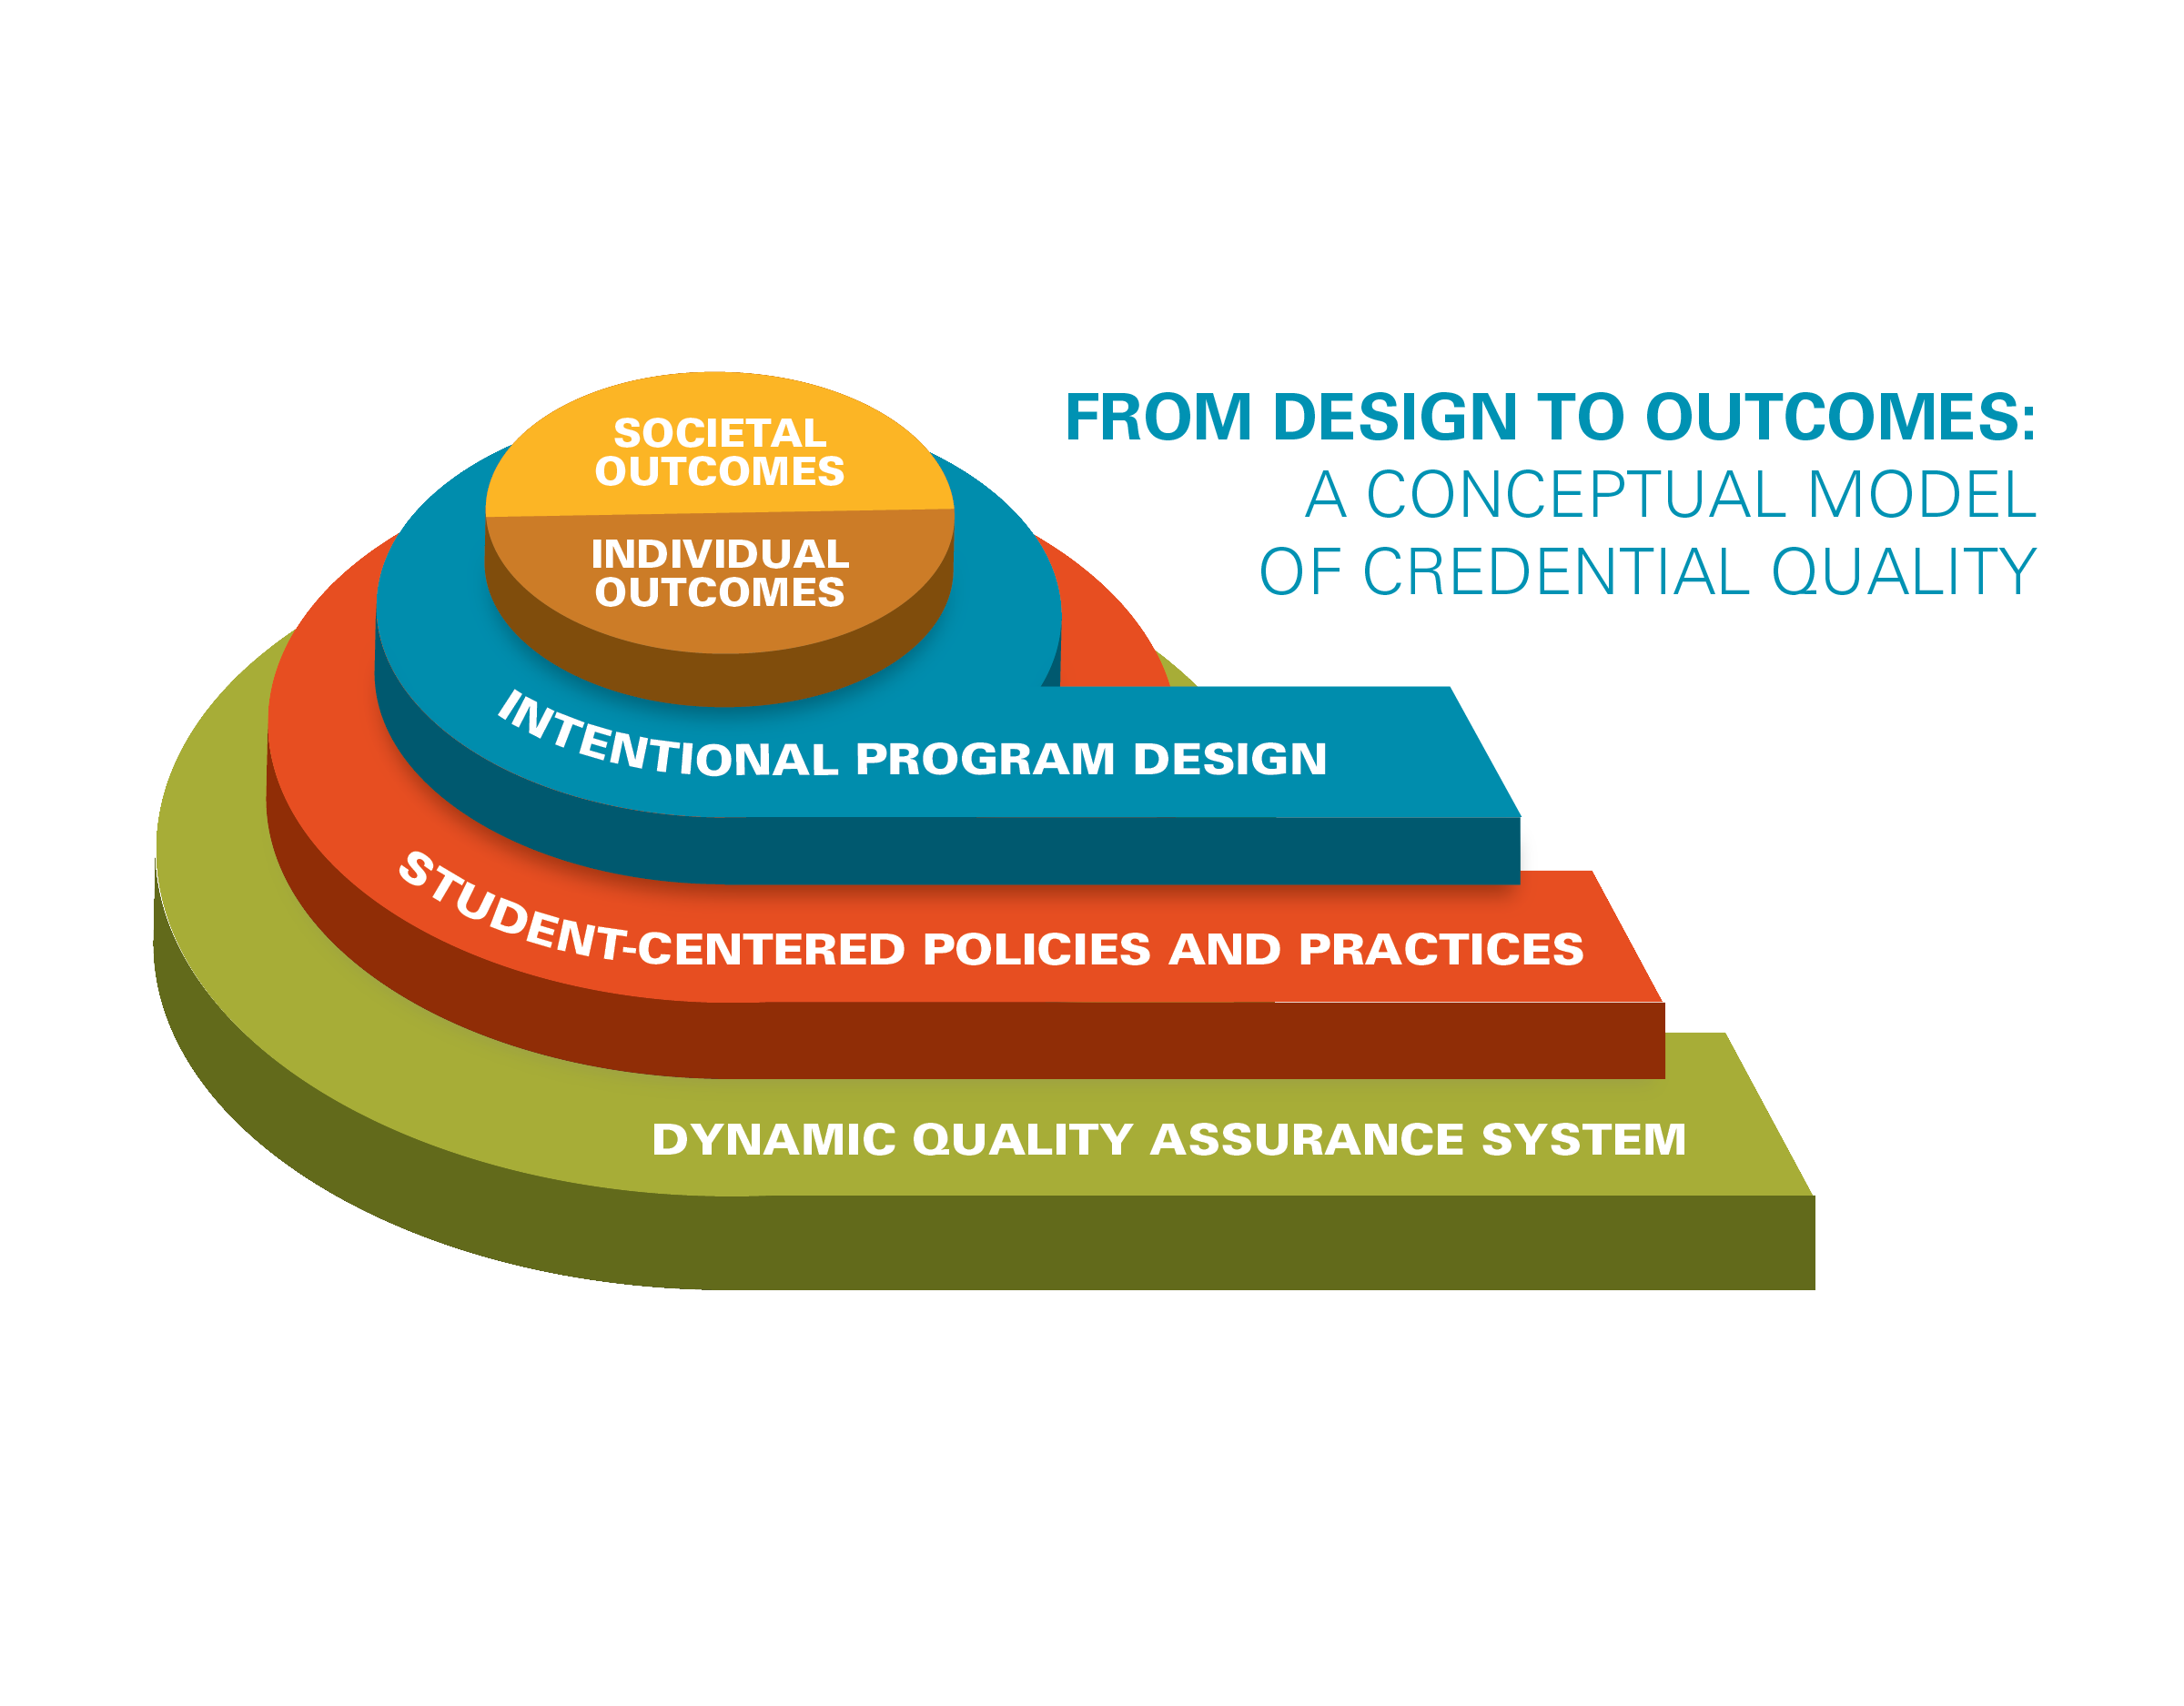
From Design to Outcomes
Mapping and addressing both what a quality credential really is and what it takes to produce one.
Notes:
While the landscape of credentialing is becoming more complex, the members of the Lumina Quality Credentials Task Force believe that we can do better to assure more equitable access to quality credentials across the entire landscape. A model that maps what a quality credential really is and what it takes to produce one can offer an essential starting point to guide reform.
We know that research suggests that increasing attainment of credentials beyond high school produces significant positive outcomes for both individuals who earn those credentials and for the communities, states, and society as a whole that benefits from a larger proportion of individuals with those credentials. We have developed a model (see Figure xx) that maps from the individual and societal outcomes we know high quality credentials can produce back to the intentional program design and student-centered policies and practices that assure the system actually produces those outcomes.

Slide 9
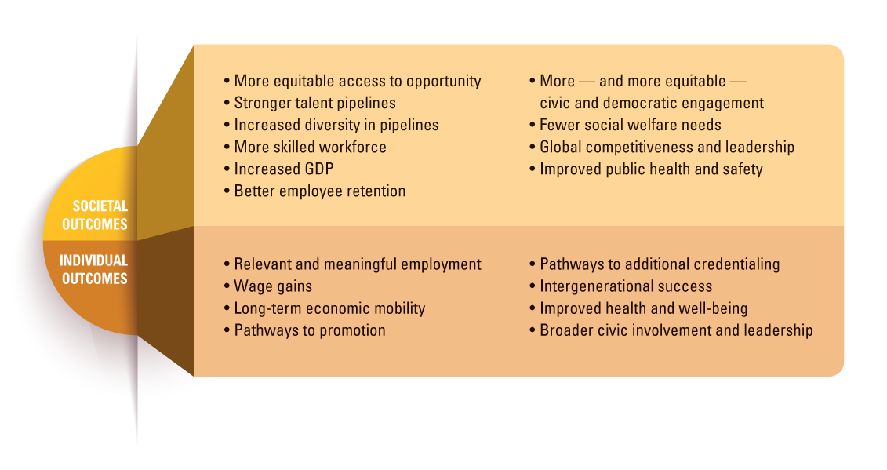
Notes:
Mapping from individual and societal outcomes we know high quality credentials can produce back to the intentional program design and student-centered policies and practices that assure the system actually produces those outcomes.
Certainly wages and employment outcomes are important, but we also wanted to highlight both short-term and longer term outcomes both for individuals and for society.
For example, we certainly believe high quality credentials should lead to relevant and meaningful employment and wage gains, but we also want our system of learning beyond high school to position graduates for longer term economic mobility and for intergenerational success, pathways to promotion and the opportunity to become responsible and active citizens and community leaders.

Slide 10
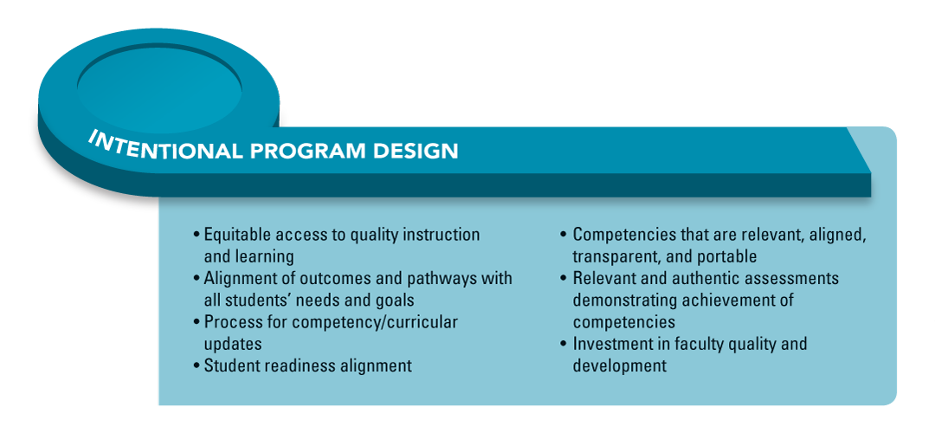
Notes:
We recognized that high quality credentials and a high quality system of learning beyond high school can produce those outcomes—but not without intentional design that takes account who today’s students are and what they actually need to succeed in their programs and after they graduate.
That changing economy is demanding new and specific competencies and we must design programs to lead to the high level achievement of those competencies. For instance, it isn’t enough to simply have knowledge or specific skills, a high quality credentials should entail actual practice applying skills and knowledge in real-world settings—and in ways that enable learners to demonstrate what they know and can do.
And, our systems by which we build faculty capacity and assess what people are learning also have to be aligned to those important—as Jamie mentioned “human skills” so important for success now and in the future.

Slide 11
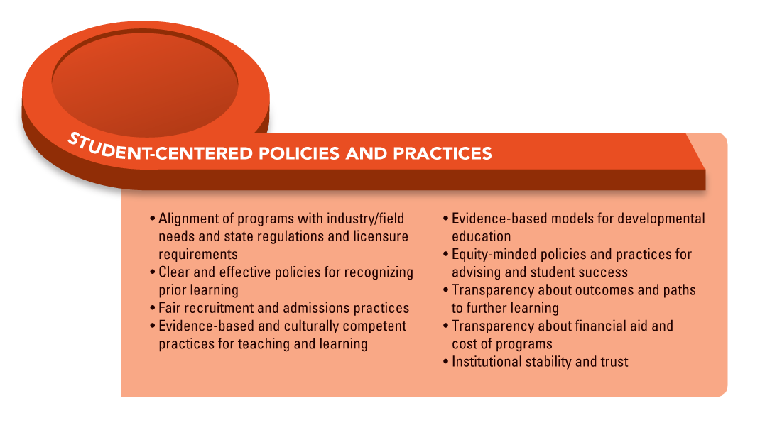
Notes:
Mapping from individual and societal outcomes we know high quality credentials can produce back to the intentional program design and student-centered policies and practices that assure the system actually produces those outcomes.
The design of the curriculum matters, but what also matters is how our institutions of higher learning understand who their students are, support them in ways that help all of them succeed and build the learning pathways within and beyond their own setting to help all students succeed.

Slide 12
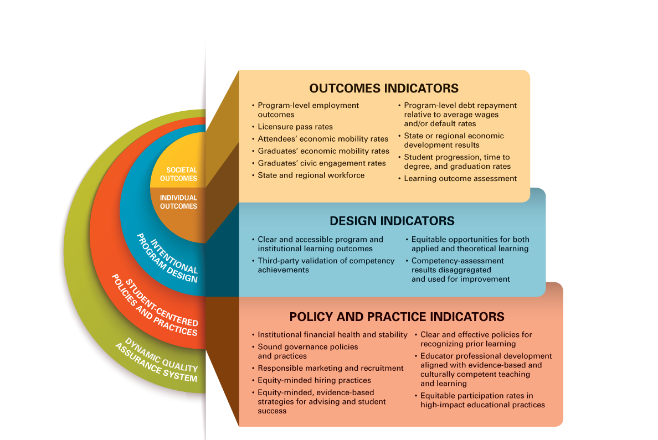
Key Indicators of New Quality Assurance System
Notes:
We know that creating better designs, policies and practices are key to the overall quality of programs and the credentialing system. We also need, however, a select set of key indicators that we can use to track quality programs and to assure quality credentials. Indicators are also necessary to determine criteria for providing resources to institutions well positioned to provide high-quality educational experiences equitably and to award high-quality credentials. See Figure xx for a limited set of indicators that align with the different component parts of the quality credential conceptual model.
Three comments about the indicators:
obviously, there isn’t just one indicator that will tell you that a specific credential or institution providing credentials is high quality.
And, while we believe these indicators can and will be used as leading indicators to help make decisions about funding and also about areas in need of improvement, no list of specific indicators will cover every possible dimension of quality.
Finally, we did not in this report specify how each of these indicators might be used—what specific levels of quantitative data might trigger some kind of regulatory action or which actors should really be paying attention to which indicators. For instance, it makes sense for federal policy to concern itself with some specific indicators relative to student borrowing and to consumer protection issues. It also makes sense for faculty and institutional leaders to track and pay attention to other sets of indicators that can help them hold themselves accountable and drive improvement.
Finally, we strongly believed that we need better and more disaggregated data on many of these indicators in order to assure that our systems aren’t masking inequities within programs.

Slide 13
It’s All About the Learning
The most important indicator of quality is one that “certifies that the credential holder has attained important core competencies.”
Notes:
We made a very conscious decision to draw particular attention to this dimension of quality—the learning and specific core competencies that we know are essential for long term success.

Slide 14
It’s All About the Learning
The competencies “essential for success in today’s workplace and for meeting the responsibilities of citizenship in our increasingly complex democratic society…critical thinking, ethical reasoning, civic awareness, and discernment in the analysis of information.”

Slide 15
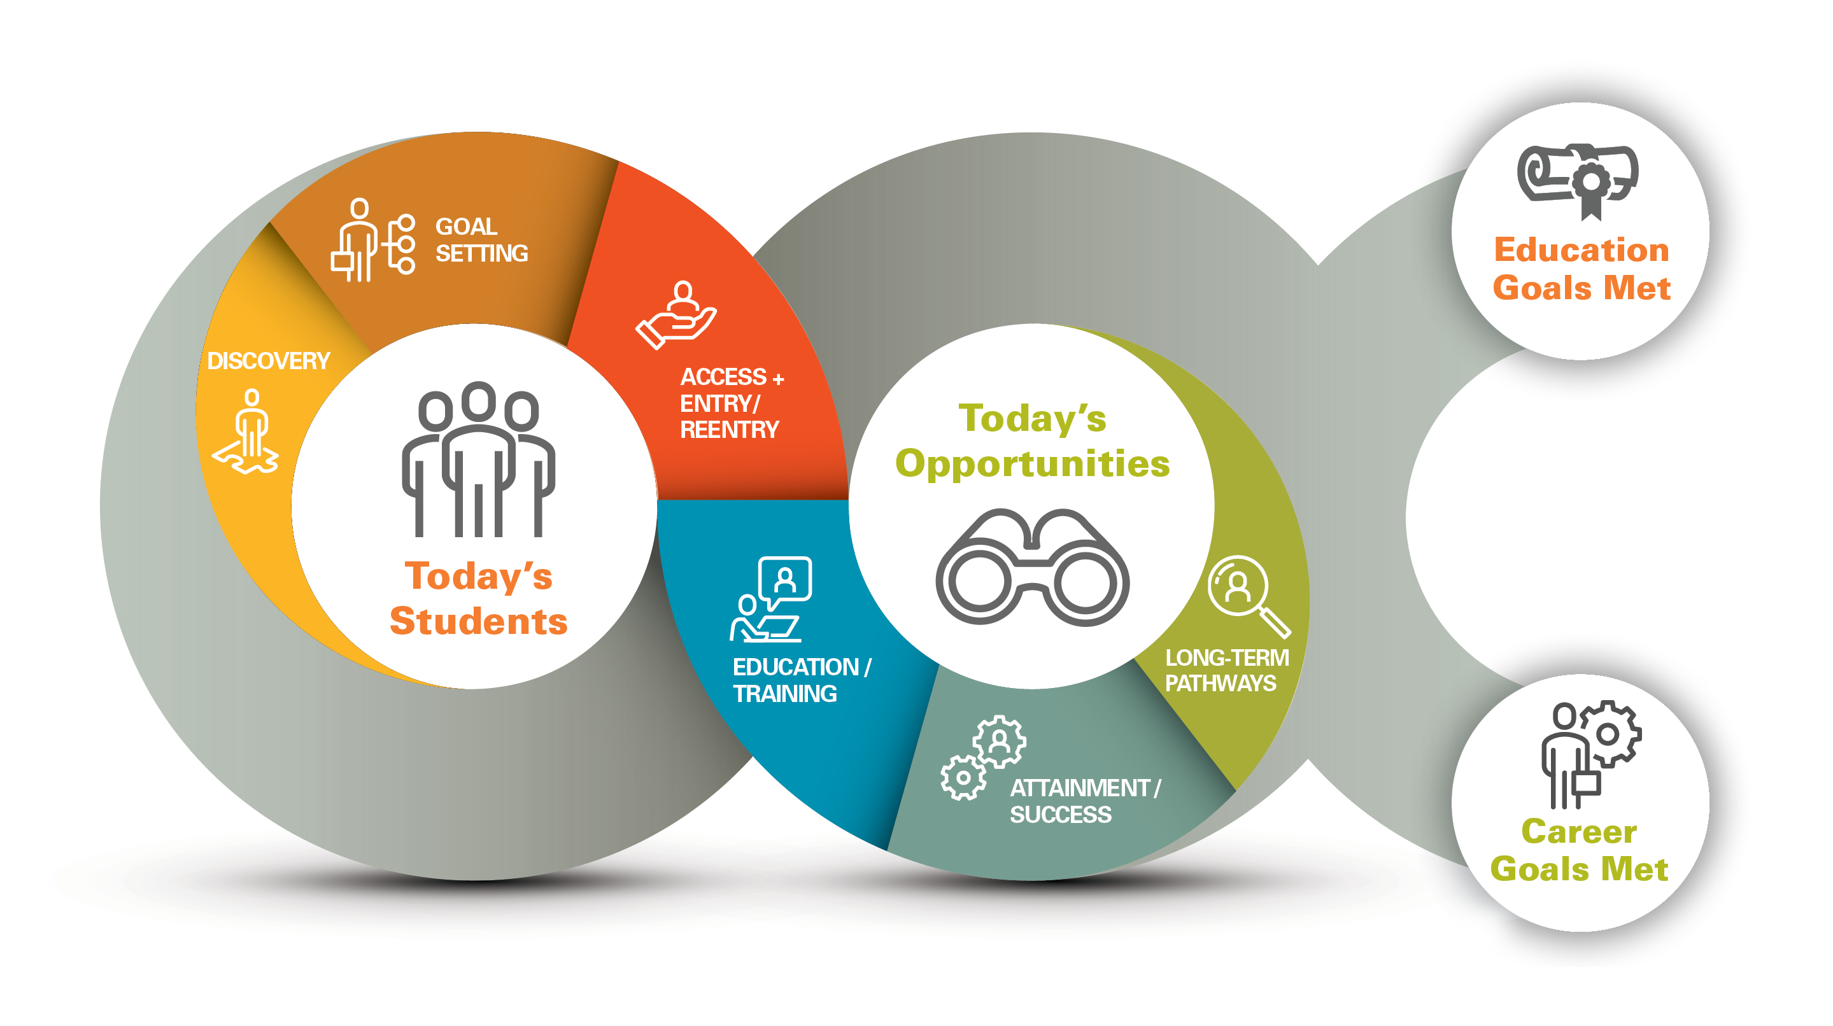
QUALITY IN THE MODERN LIFECYCLE OF LEARNING

Slide 16


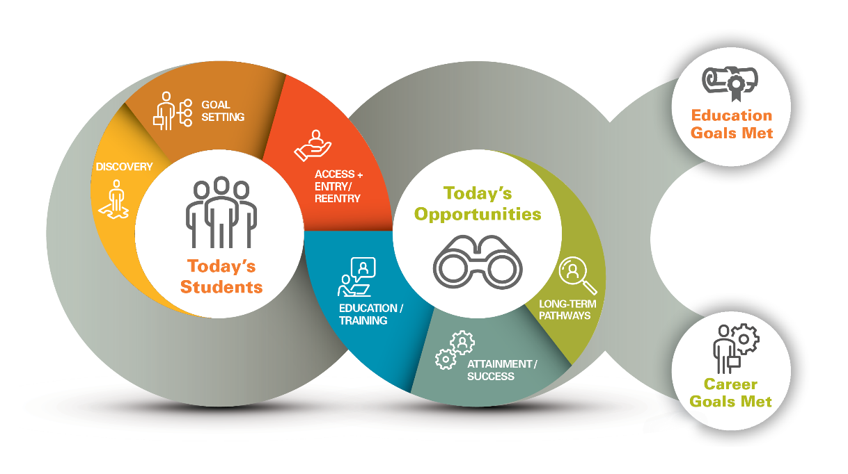




FREDERICKA
EVELYN
First-generation
college student
Traditional age
MARCUS
KATRINA
Veteran
Returning adult with some college credit
ALEJANDRO
BINJAMIN
Formerly incarcerated
New entering student with several certificates

Slide 17
ASSURING QUALITY ACROSS TODAY’S STUDENT PATHWAYS
Evaluation Activity
Individually, select a student profile.
Using the conceptual model as your guide, answer the questions on the provided worksheet.
Share your insights.
30 minutes
Notes:
At the end of 30 minutes, we will facilitate 10 minute discussion with broader group on findings of exercise.
Debra: Do we have enough time to have them answer the questions in 20 minutes? Then, 10 minutes of discussion at the tables about their answers? Then, the full group read-out?

Slide 18
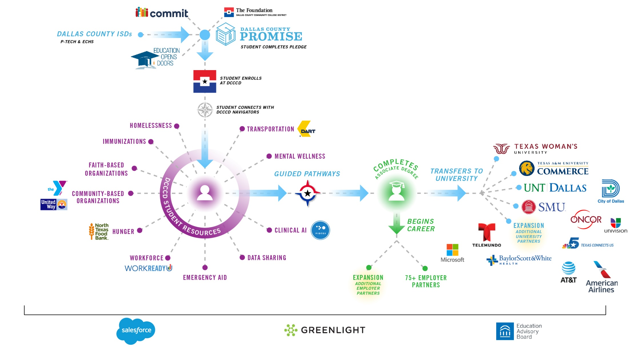
Network Strategy
Solving the talent problem will take the entire community to address the equity and poverty challenge. Every dotted line represents a handoff and a point of failure for our most vulnerable students.
Notes:
This is a slide that Joe May wants to use. We won’t bring it up right away but Chauncy can signal when it is appropriate.

Slide 19
Five Priority Areas for Collaboration
To Create the Most Positive Impact for Students
Notes:
No single actor or sector can design, build, implement, and maintain the student-centered quality assurance and improvement system we believe to be necessary—and overdue. A wide range of actors will need to contribute, including accreditors, educators, employers, federal agencies, institutions and systems, states, students, philanthropic organizations, and workforce boards. Each of these actors will have its own role to play – and will need to work more readily and effectively with the others.
The necessity for increasing collaboration and coordination has been a consistent theme in quality and improvement discussions for a long time. We hope to advance the conversation by identifying a few concrete places to start. Task Force members have helped identify five priority areas where collaboration and coordination would create the most positive impact for students.
These priority areas and sample illustrations represent steps that various actors might take to move our quality assurance and improvement systems forward. Though the list of possibilities can be daunting, systems change can start with a set of actors choosing one priority area as a starting place for relationship development and activity alignment. That could be a relatively simple effort to support just one institution through a tough time or to align metrics for a single priority sector for a state’s workforce development. Such initial first steps could build trust, reveal unknown resources, and establish a greater tendency toward collaboration. Building a quality assurance and improvement system will not happen overnight. We look forward to learning together in the years to come.

Slide 20
1
Generate and Use Strong Data Sets
Different actors using different facets of the data to facilitate stronger collaboration, reduce duplication, and enhance decision-making.

Slide 21
2
Operationalize a Commitment to Quality and Equity
Different actors developing new relationships, hearing and responding to new perspectives, and being ready to succeed and fail along the way to correcting historical wrongs and creating a brighter future for all.

Slide 22
3
Build Seamless Pathways
Connect and align systems and providers so today’s postsecondary students have more opportunities for learning, skill development, and growth than ever before.

Slide 23
4
Support Faculty Development and
Collaboration
Faculty members must lead program redesigns. Working collaboratively, the nation’s scholar
teachers can design programs that will ensure effective learning among their diverse students.

Slide 24
5
Plan for Institutional Closures and Mergers
Develop more proactive, collaborative approaches that protect student, community, and taxpayer interests while contributing to institutional stability and sustainability.

Slide 25
To Create the Most Positive Impact for Students
Five Priority Areas for Collaboration
1
Generate and Use Strong Data Sets
2
Operationalize a Commitment to Quality and Equity
3
Build Seamless Pathways
4
Support Faculty Development and
Collaboration
5
Plan for Institutional Closures and Mergers

Slide 26
PRIORITIES FOR CHANGE
Closing Activity
Building on the new model and indicators framework and your various takeaways from the workshops, jot down on the provided worksheet:
Two top priority reform next steps for your own sector or institution/organization to take to advance quality and equity for today’s students
Two top priority reform next steps that are most important for individuals in other sectors to take to advance quality and equity for today’s students
One critical reform collaboration—and who should be collaborating with whom—to advance quality and equity for today’s students
30 minutes
Notes:
Asking people to write down answers to three questions:
Two top priority reform next steps for my own sector or institution/organization building on the new model and indicators framework
Two top priority reform next steps that you think others in other sectors need to take
One additional area where collaboration will be key—and who should be collaborating with whom

