Slide 1
A new CSR and eT
Joellen Shendy

Slide 2
Key Points
GOAL
A new way to evidence student learning
  Allows the student and other stakeholders greater transparency into what a student knows and can do
The problem we are trying to solve:
Current transcript shows what courses were delivered – not the learning that occurred
  It’s all text and abbreviations
Students and others struggle to:
  Make cross cutting connections across the curriculum
  Articulate what a student knows and can do
  Demonstrate value of the degree or credential they have earned
Notes:
Cryptic Records
See learning more holistically
Relevance to employers strategic talent need (Jamie Meristosis America Needs Talent Book)

Slide 3
Trends
Emerging models and trends like CBE, micro-credentials and credential stacking
  Impact on:
    Completion rates
    Affordability
    Building a lifelong learner for the career of the future
    Access and Opportunity
    Where learning occurs (time, place, and space)
    Transparency of outcomes and competencies

Slide 4
Opportunities
The non-completers dilemma
    Break the failure paradigm – turn their “didn’t complete” into an array of things they can do to demonstrate value
Transfer and portability
  Move from a course based credentialing system
  Transparency
  Deliver only the education needed
    Assessment avenues opening
Credential chaos
  From confusion to clarity
Notes:
Industrial age vs knowledge economy

Slide 5
Challenges to be overcome
Silo structure in higher education
Academic terminology prominent
External organizations in the driver seat
Technology systems and interoperability
Student artifacts – and privacy concerns
Stakeholder needs and audience not homogenous
Co-curricular for adult students not on campus
Notes:
Employers – we mostly mean large firms with 500 or more employees who have rich and robust HR departments
64% of U.S. Business net new private sector jobs and about 40-50% of the payroll
Learning While Earning: Georgetown CEW report 70% of college students are working while enrolled – 1/3 of these learners are 30+, 19 percent have children, 25% are working FT and learning FT, 40% of undergraduates and 76% of graduate students work at least 30 hours a week.

Slide 6
Paradigm Shift
In the future, students will have more control over their own academic records, and registrars will be responsible for overseeing the sharing of verified data

Slide 7
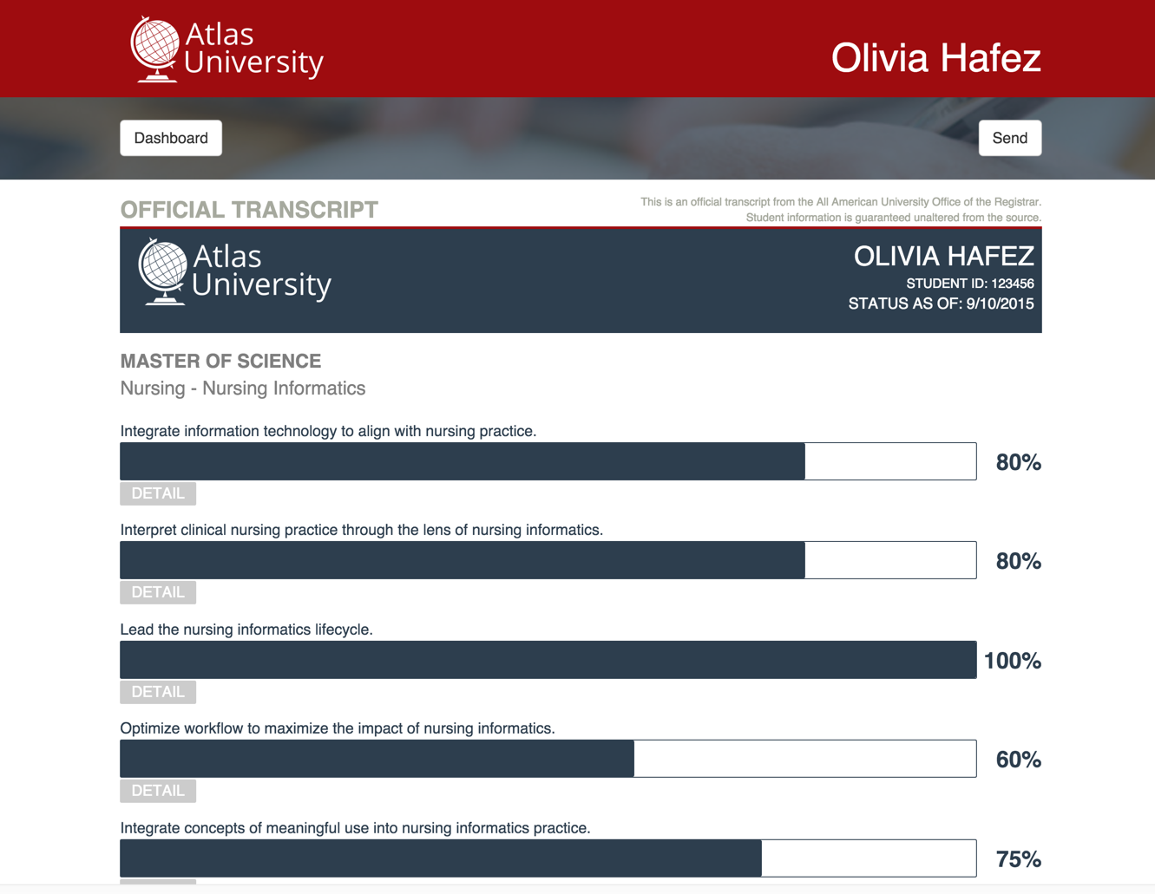
Notes:
TIP Project – opportunity to tie to courses, industry certifications, frameworks like DQP, etc

Slide 8
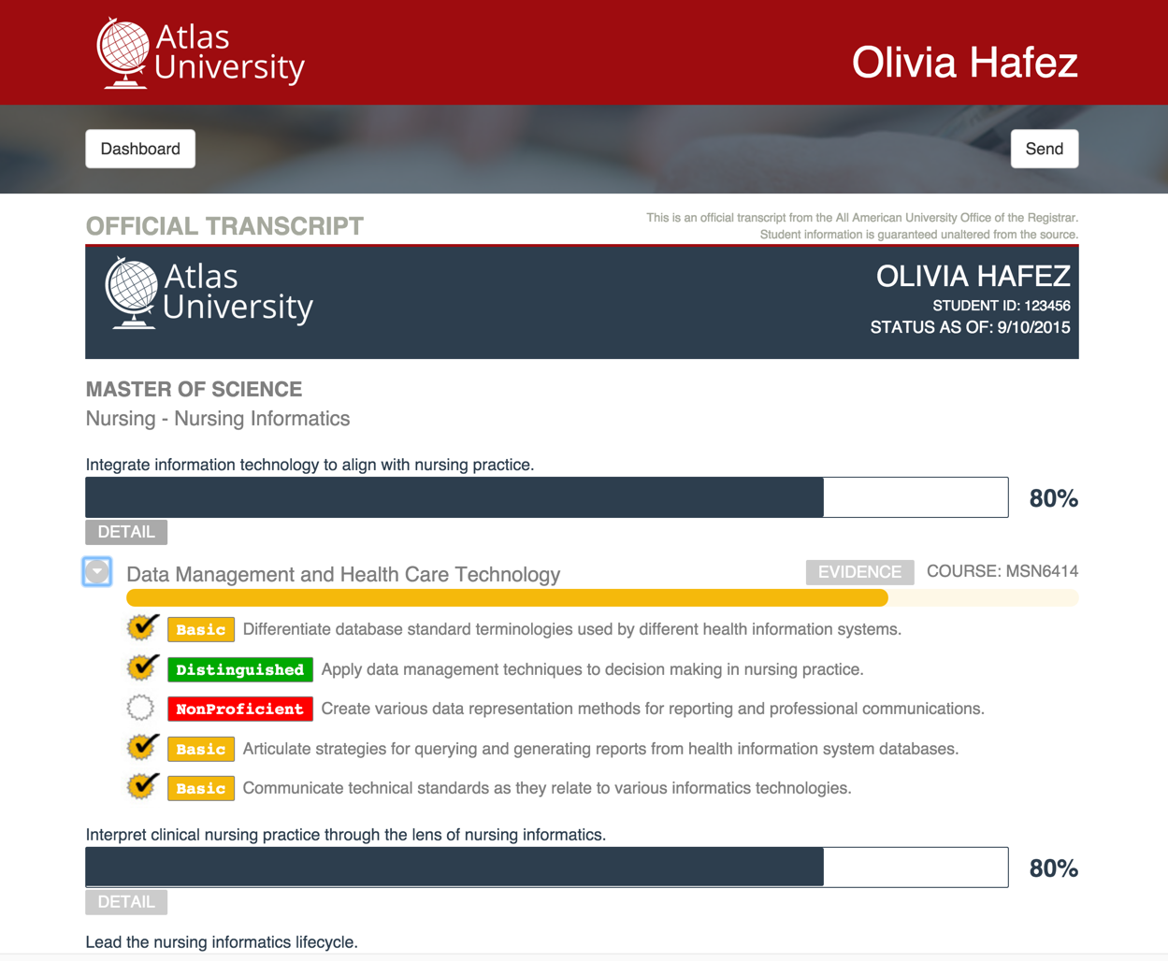
Notes:
TIP Project

Slide 9
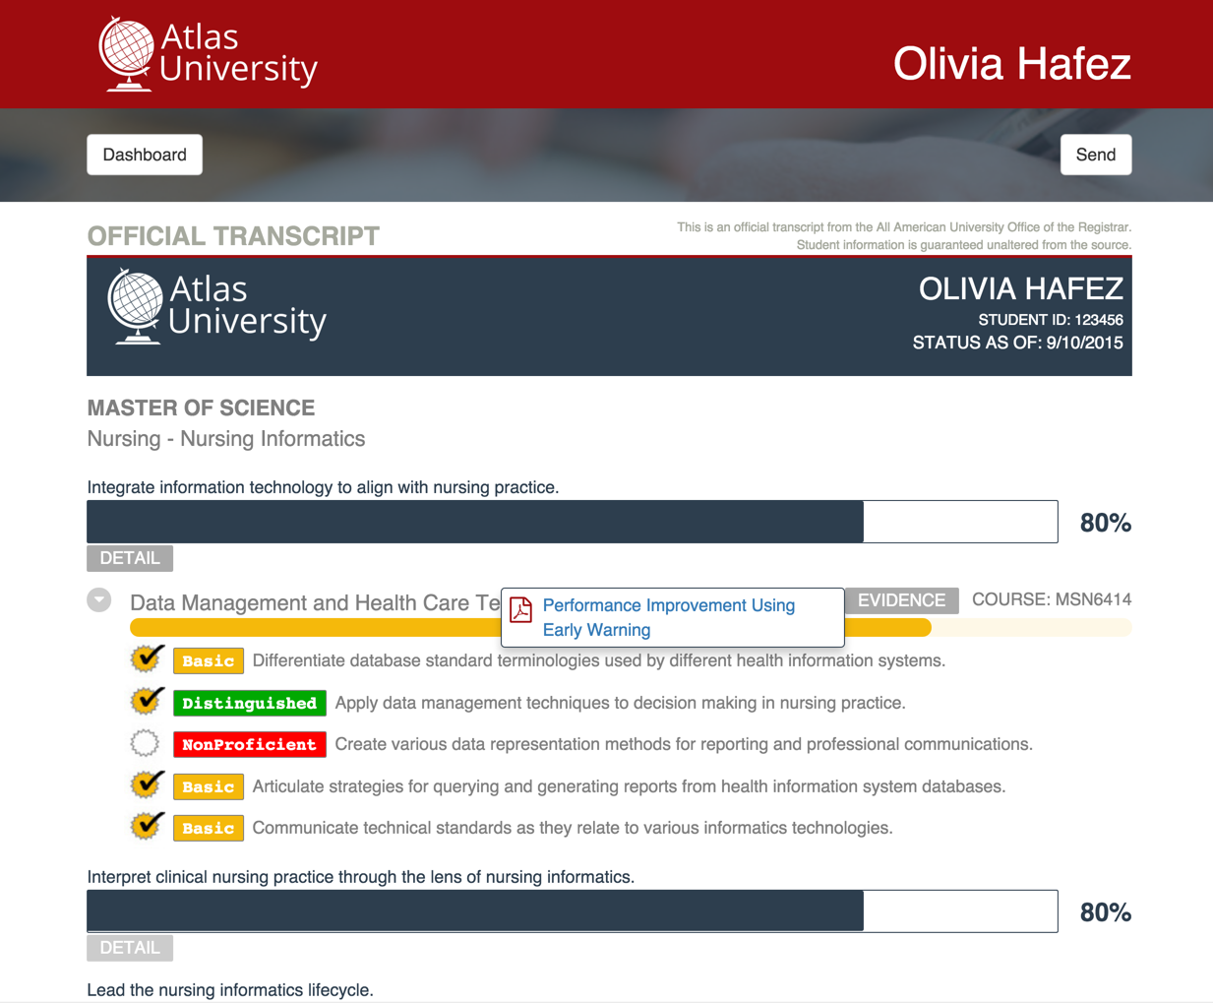
Notes:
TIP Project

